Slide 1
Discrimination Types in Turkish for Foreigner Books
(Istanbul Turkish for Foreigners Books Sample)

Slide 2
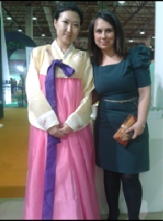

Discrimination Types in Turkish for Foreigner Books
Ezgi Ağcihan
English and Turkish Language Teacher at Kadikoy Adult Education Center , Istanbul,Turkey
Phd Candidate at Institution of Social Studies, Education Management Department, Kocaeli,Turkey
14th IARTEM Changing Media Changing Schools? Conference

Slide 3

Discrimination Types in Turkish for Foreigner Books
14th IARTEM Changing Media Changing School? Congres

Slide 4
Why are textbooks are important at language learning?
1. the basic source of learning
Text books can be the basic source of learning when the target language is not spoken in the country where the language is being taught.
2. play an important role in shaping thethe historical, cultural and social perception of the learners.
The cultural heritage of textbooks transmits values to the future generations.

Slide 5
Why are textbooks are important?
Pingel (2010: 7) states that textbooks contain fictional texts, books and stories with a lot of information, reality, and numerical data, so there are clear signs that the textbooks contain behavioral patterns, norms and rules that adults want to convey to future generations.
Apple (1993) defines textbooks as "official knowledge of the communities” that set international boundaries.
Touraine (2000: 265) notes that textbooks are one of the most important elements reflecting the dynamics and structure of the society.

Slide 6
Discrimination Types in Turkish for Foreigner Books
It is argued that the explicit or implicit messages in text books may lead to social polarization and the formation of societal mental boundaries and the stereotypical beliefs and disrimination in society.

Slide 7
Discrimination Types in Turkish for Foreigner Books
Altbach (2010) notes that the social conflicts and struggles in textbooks are one of the most important issues nowadays the educational practice, as the reflections of national identity are included in educational texts.
Herglson (2010) points out that as a result of economical, political and social concerns of publishing houses, the authors are criticized to be a spokesman of the pressure groups. The idea of objective, unbiased information in text books could be an illusion .
Fleming (1990:7) argues that it is more crucial to provide objective knowledge and basic skills in the course materials, such as improving writing and reading and gaining critical thinking ability by using ethical systems rather than emphasizing nationalism.

Slide 8

The Definition of Discrimination

Slide 9
Discrimination occurs when people are treated less favourably than other people are in a comparable situation only because they belong, or are perceived to belong to a certain group or category of people
(European Union Agency for Fundamental Rights, 2017)

Slide 10
Discrimination Types
The Type of Discrimination declared in the European Non Discrimination Law by European Union Agency for Fundamental Rights
Age
Race
Ethnicity
Disability
Skin Colour
Gender /Sexual Orientation
Occupation
Pregnancy
Individual differences
Marital status
Social Status
Belief/Religion
(European Commision,2017)

Slide 11
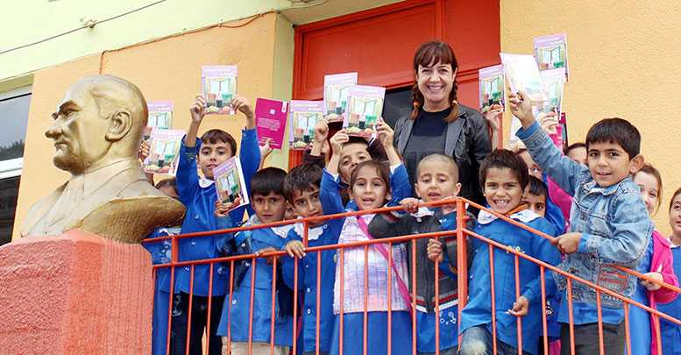
Discrimination in Education
The researches are limited to gender and nationality discrimination

Slide 12
The Aim of the research
To analyze the Turkish for Foreinger Course Books according to the discrimination types which is stated stated in European Non Discrimination Law by European Union Agency for Fundamental Rights.

Slide 13
Researh Questions
1. Are there discriminatory expressions in written and vocalized texts?
2. Are there elements of discrimination in the visuals (graphics, pictures)?

Slide 14
Research Model
In order to examine the discrimination types in
Turkish For Foreigner Textbooks in depth
Qualitive Approach
Content Analysis Approach was chosen.

Slide 15
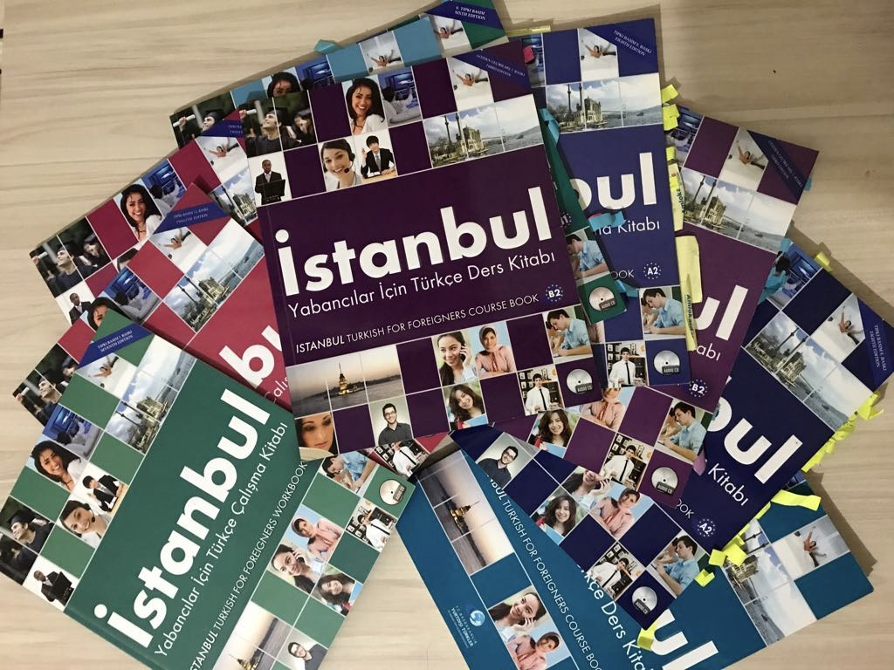
Reseach Material

Slide 16
Findings
Categories
Gender
Age
Physical Apperiance
Martial Status
Religious
Etnicity

Slide 17
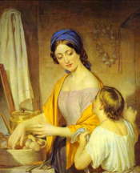

Discrimination Types in Turkish for Foreigner Books
1. Gender Discrimination Properties

Slide 18
Discrimination Types in Turkish for Foreigner Books
Presentation of men and women in a traditional patriarchial unequal distribution of social roles
“ When I wake up I go tho bathroom to have a shower and my wife prepares the breakfast.’’(B1, p 24)
“ With the headchef of my grandmother all of the girls go to the kitchen to cook.’’ (B2, p19)
“ If we had a dishwasher I wouldn’t spend all my time by washing the dishes.’’(Said by a female character Nazan, B2,P39)

Slide 19
Discrimination Types in Turkish for Foreigner Books
women are expected to represent fixed traditional roles and “if necessary sacrifice herself for her husband, and children.’’
“I dropped out schooling after high school. I fell in love and got married in a year. Then I gave birth three times in fifteen years. I got everything what I desired. A good husband, a home and three children……..’’(C1,p 67)

Slide 20
Discrimination Types in Turkish for Foreigner Books
Sexist point of wiev in the language used in the textbooks for example in stead of using “scientist’’
“space man’’ “ bilim adamı’’ or for “executive’’ “ işadamı “ business man’’
“Ahmet Bey is a successful business man.’’(A2,p 19)
“ Space men made an important discovery in Mars.(A2,p5)

Slide 21
Discrimination Types in Turkish for Foreigner Books
the form of “bayan” or “kız” or “hanım” (miss, lady) are chosen to avoid to use the word “kadın”
In the example below learners are asked to match the pictures with the defiinitions. For man the word
“ erkek’’ is used to define gender but for the gender female the authors choose to use bayan or kız for the people over 25 years old

Slide 22
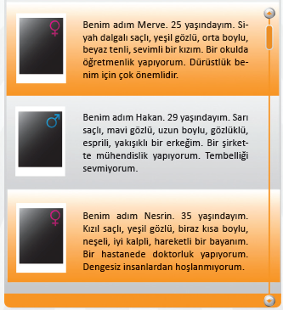
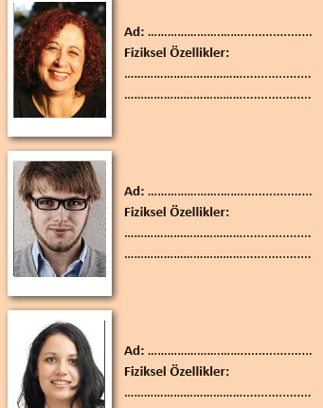
Discrimination Types in Turkish for Foreigner Books
(A2,p 16)

Slide 23
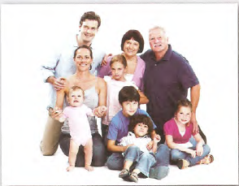

Discrimination Types in Turkish for Foreigner Books
2.Martial Status Discrimination Properterties

Slide 24
Discrimination Types in Turkish for Foreigner Books
When family is mentioned in the Turkish For Foreigner Textbook, what is meant or portrayed in general, “the modern nuclear family ” consisting of mother father and children and “extentended family” consisting grand parents and relatives. According to the expressions and visuals in the texts; single parents or homesexual marriages, or the childless couples are ignored.

Slide 25
Discrimination Types in Turkish for Foreigner Books
‘’In Turkish Society Family is a precious structure and reflects the society’s language, religion and other values. Family is the smallest unit of the society. At our Constitution’s 41st act the importance of the family is promoted. When we consider family the fisrt thing we remember can be mother, father and the children. Social scientists describes family in two ways nuclear families and extended families. In our country when people get married they leave their parents and start to live in another home………(B2,88)’’

Slide 26
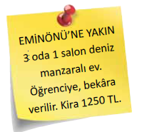
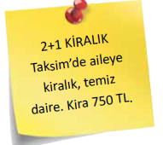
Discrimination Types in Turkish for Foreigner Books
According to the book marriage is shown as the only way to live as an adult in society. And being single or living with your partner might be a problematic and challenging situation against the norms and values.
(B1, p8)

Slide 27
Discrimination Types in Turkish for Foreigner Books
Estate Agent: Miss Gamze do you live with your family or alone ? I’m asking this because some flats are rent just for families
Gamze:I live alone
Estate Agent:So I have some houses in Levent suitable for you which is the modern part of the city.
(B1,p 11)

Slide 28
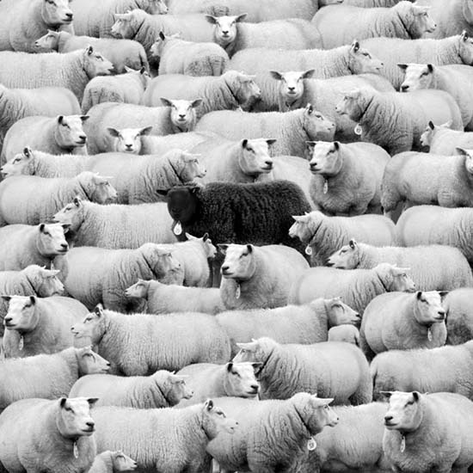
Discrimination Types in Turkish for Foreigner Books
3. Physical Apperiance Discrimination Properties

Slide 29
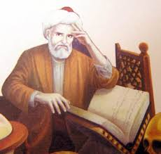
Discrimination Types in Turkish for Foreigner Books
Erzurumlu Ibrahim Hakkı, who is a scientist and Sufi and lived in 18th century, analyzes the people’s characters according to their physical apperience.

Slide 30
Discrimination Types in Turkish for Foreigner Books
……..Analizing people’s characters according to thier physical apperiance. the tall people are clever and naive, the short ones are tricky. The ones with stiff hair have sharp mind. The ones with thin hair are considetare, wise and elegant. The ones with big heads are really clever.If the one has many wrinkles on his/her forehead this person is kind.If the one has a few wirnkles this person is generous.The ones with big ears are ignorant and lazy.If the people have middle size ears these people are honest.The people with blue eyes are smart, the ones with hazel eyes are good hearted.The ones with tall noses are unapt and the ones with short noses are coward.The people whose the tip of noses are like a ball are joyful and the people with small mouth are beautiful but coward at the same time on the other hand the ones with big mouths are courageous.
(C1,56)

Slide 31
Discrimination Types in Turkish for Foreigner Books
‘’ White
If a man likes white colour he is never coward. People like that are calm and introverted. They are unhurried and cautious. If a woman likes white colour she is kind, caring, elegant and helpful. They are skillful and faithfull.
Yellow
If a man likes yellow he is a bit coward but he never hestitates to tell his ideas. But he never hestitates to tell his feelings. His talkings might be manupilating. If women like that colour she likes gossip. They talk all the time and what they tell might be interesting…….’’( B1, p 60)

Slide 32
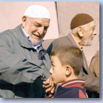
Discrimination Types in Turkish for Foreigner Books
4. Age Discrimination Properties

Slide 33
Discrimination Types in Turkish for Foreigner Books
In Turkish culture aging is a matter that can be respected and being older is associated with getting wiser. By the way, it also effects language even you are a stranger it’s normal that people call you “ amca” (unlce) or “teyze” (aunt) as it ‘s a way of showing your respect.

Slide 34
Discrimination Types in Turkish for Foreigner Books
‘’When we call someone as man or woman we prefer to use uncle/or aunt in Turkey. Another way to show respect and love in Turkey is hand kissing behaviour. The younger ones kiss the hand of older ones and put it to his/her forehead after that…..’’
(C1, p35)

Slide 35
Discrimination Types in Turkish for Foreigner Books
‘’ …. My moher even doesn’t know how to swith on the mobile phone.She cannot fing the names on contact list. She can’t us shortcuts. My mother says “don’ t get angry with me as I’m old what can I do? I’m an old person.” (p33,B2)

Slide 36
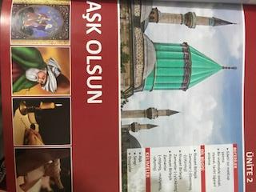
Discrimination Types in Turkish for Foreigner Books
5.Religion and Ethnicity

Slide 37
Discrimination Types in Turkish for Foreigner Books
However the Turkish citizens are diversive in terms of their religion and beliefs and ethniciy.The representaition of the identity is singular. When the examples are examined, it has been seen that the Sunnni Islamic Turkish etnicity is highlighted and priviledged.

Slide 38
Discrimination Types in Turkish for Foreigner Books
Useage of the visuals of mosques and muslim sufis or sunni etnicity
Giving examples of morals from Koran and Khalifs of Muhammed.
‘’People look like the time they live more than their fathers.’’
Hadisi Sherif(B2,p 16)
‘’The magic of speech art is stopping to use meaningless words.’’
Hz. Ebubekir(B1,p 28)

Slide 39
Discrimination Types in Turkish for Foreigner Books
Discussion and Conclusion
As Bank states(2010) in order to achieve a succesful teaching athmosfer we should desing the curriculums and learning materials with a multicultural and diversive perspective but as we see in the examples The Turkish for Foreigner Text Books do not have these features.

Slide 40
Discrimination Types in Turkish for Foreigner Books
However the foreing language text books are narratives of the the culture which is being thought the text books should be written with a global and scientifistic perspective in order to adress the 21st centuries learners.Morover, they should be published away from subjective political concerns and predijudges and bias.

Slide 41

Discrimination Types in Turkish for Foreigner Books
Thank you for Listening to Me

