Slide 1
Fill in packages Retrospective
Ruth Firer (Ph.D.) Hebrew University of Jerusalem

Slide 2
. Origin 2
The Israeli-Palestinian Conflict in History and Civics Textbooks of Both nations
By
Ruth Firer and Sami Adwan, Verlag Hahsche Buchhandlung, Hannover 2004

Slide 3
. “To Learn to Live Together”3
(1998-2000)
Five years Action Research project (1998-2000) by Truman Institute HU (IS), Wi’am (PA) and UNICEF.
In the seventh grade classes of Israeli school in Jerusalem (Beit Chinuch Tichon) and a Palestinian school (Talitha Kumi.) Also scout troop of both sides. Supervised by Ruth Firer (Ph.D.) The Hebrew University of Jerusalem (IS) and Sami Adwan (Ph.D.) The Beit Lethem University (PA)

Slide 4
. 'Fill in Packages' 4
Additions to Israeli and Palestinian textbooks and teaching, based on Peace Education (PE) and Human Rights Education (HRE) aiming to encourage pupils’ curiosity, critical thinking and tolerance.
Within History, Civics, Literature/language, English, and Geography textbooks and curricula of the 7th grades of both nations.

Slide 5
5. Twenty IS &PA teachers
Joint and separated teacher training, reading critically textbooks (verbal and non verbal) and looking for 'vacuum' spots, stereotypes etc. Creating teacher peers of the same subject. Anonymously opinion questionnaires and oral interviews, to be compared to their answers after the completion of the project.

Slide 6
Teachers’ Problems: 6.
The teachers changed, mostly had negative opinions.
Language: English + problems in the translation.
PA teachers blamed the Israeli side.
IS teachers tried to focus on the HRE &PE project and get frustrated and tired. No peers of PA &IS teachers were established.

Slide 7
7. Examples of IS Fill in Packages
Geography: Muslims in West and East Jerusalem.
History: Spain – Inquisition and exile (1478-1492): Jews and Moslems. The Ottoman in Israel/Palestine (1516-1917): co existence.
Literature +English: positive Muslims and co existence.
Similar words in both languages.
Civics: Attitude to Muslim minority in Israel (all were invited to IS class 30.11.99)
.

Slide 8
8.Problems in Fill in packages
It took more than 10 min. Too much work for .teachers
The Palestinian teachers didn't share their written
Fill in Packages with their Israeli partners
neither with the UNICEF - the third party.

Slide 9
9. Teaching
Students, experts and the supervisors were to watch and evaluate according to questionnaire composed by Firer and Adwan.
IS. Examples: all the participants were invited to watch the Citizenship Israeli classroom. Firer filmed a lesson in English in Israeli classroom, and her students were watching IS lessons and writing reports on them.

Slide 10
10.Problems in teaching
IS students wrote reports on IS classroom - PA teachers did it on their side. The UNICEF delegate/observer reported that the PA teachers merely preached good manners.
The PA reports and the questionnaires were written by the same school teachers and were not shared with the Israelis.

Slide 11
(12-14) 12.Sevety pupils
The parents agreement was achieved ahead. Differences between schools. Plans to bring all the pupils to joint activities like, sport, newspaper, theatre and excursions. All pupils were anonymously questioned to be compared with their opinions after the completion of the project .

Slide 12
12.problems- Pupils
Many pupils on both sides had already strong opinions against the other side. Quite few knew persons who were hurt by the conflict.
The second joint stage was never reached.
Scouts: meetings with the leaders were held- but it didn't reach the scouts.

Slide 13
13.Publishing
'The Truman Institute for Advancement of Peace,' The Hebrew University of Jerusalem, and the UNICEF representative to Jerusalem were fully aware of the above mentioned problems.
They decided to end the project, advising to avoid any academic publication.

Slide 14
14.Retrospective outlook
The project failed, mainly because one side is the occupier and one is the occupied.
But the retrospectively I believe that when the PE and HRE NGO’s are resented by authorities and teachers, this Fill in Packages is a “dripping water system” that uses the existent infrastructure and can work…

Slide 15
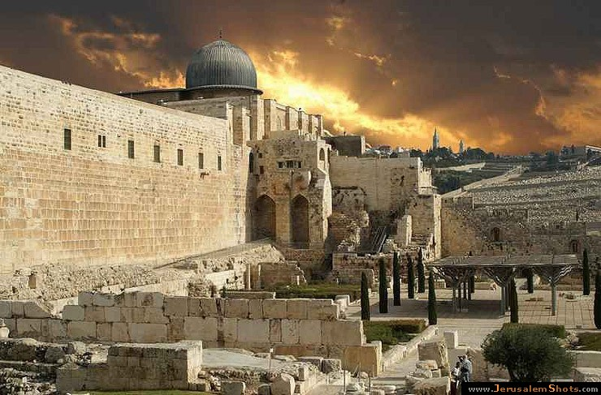
15. Questions?
Jerusalem between past and future

